Slide 1

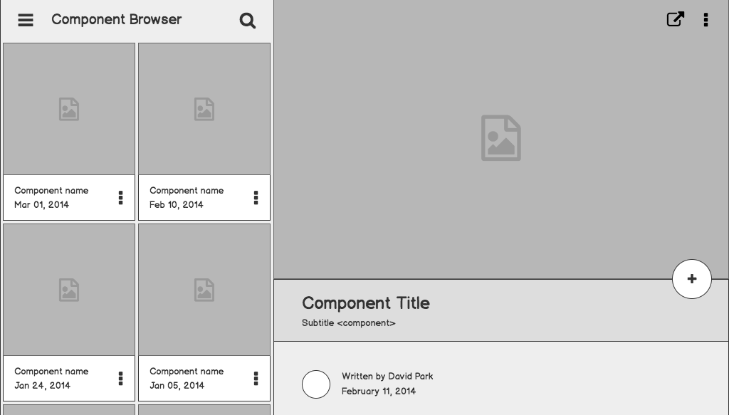


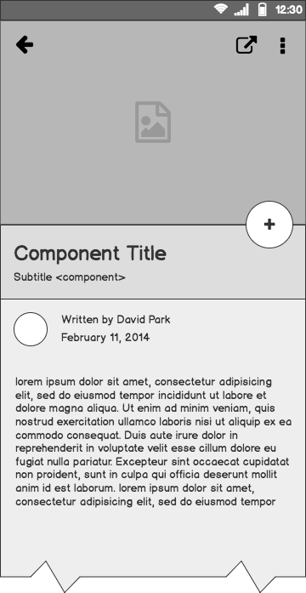

RecipeRealm
Recipe Management Web Application
Rohan Mehta
Frederick Phillip Javier
Ammar Alquran

Slide 2
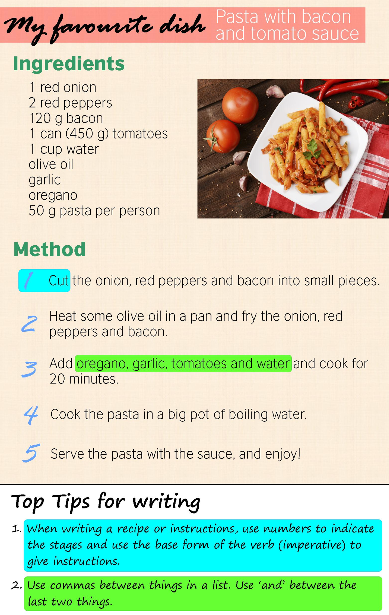
Objective
Problem: Recipes are hard to manage
Solution: Develop a web application for creating, searching, and managing recipes

Slide 3




Tech Stack
FRONT END
BACK END
BACK END
DATABASE

Slide 4
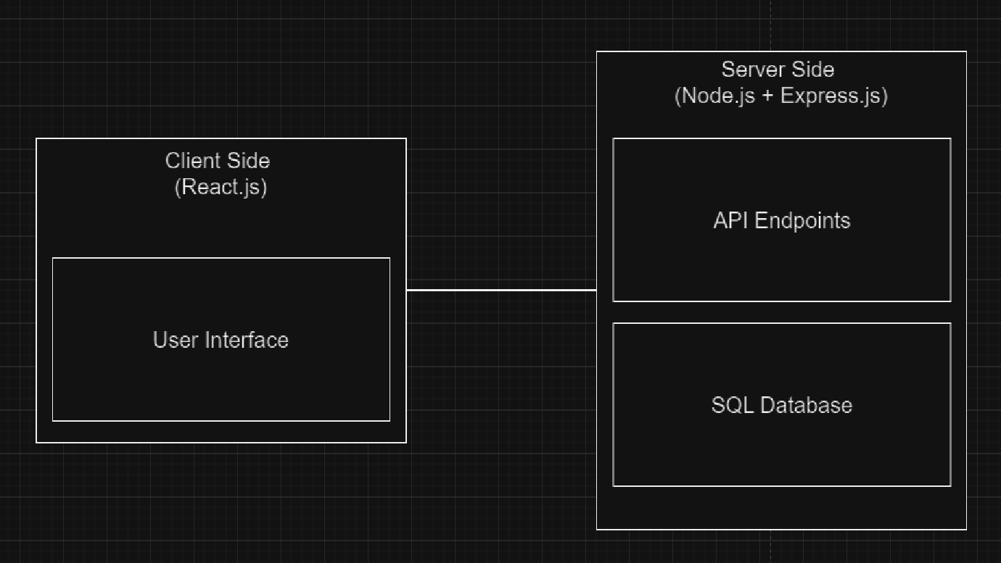
Project High-Level Design
Recipe management system:

Slide 5
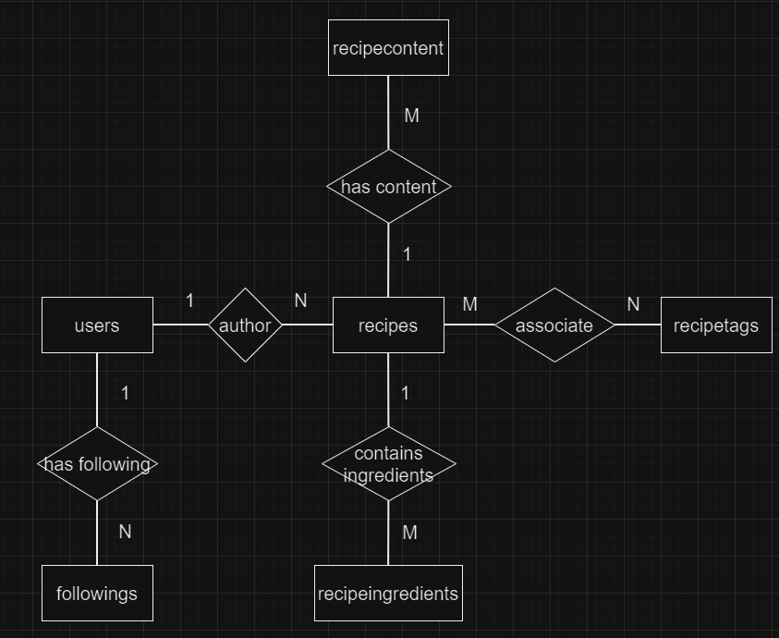
Database Design
ER Diagram:

Slide 6
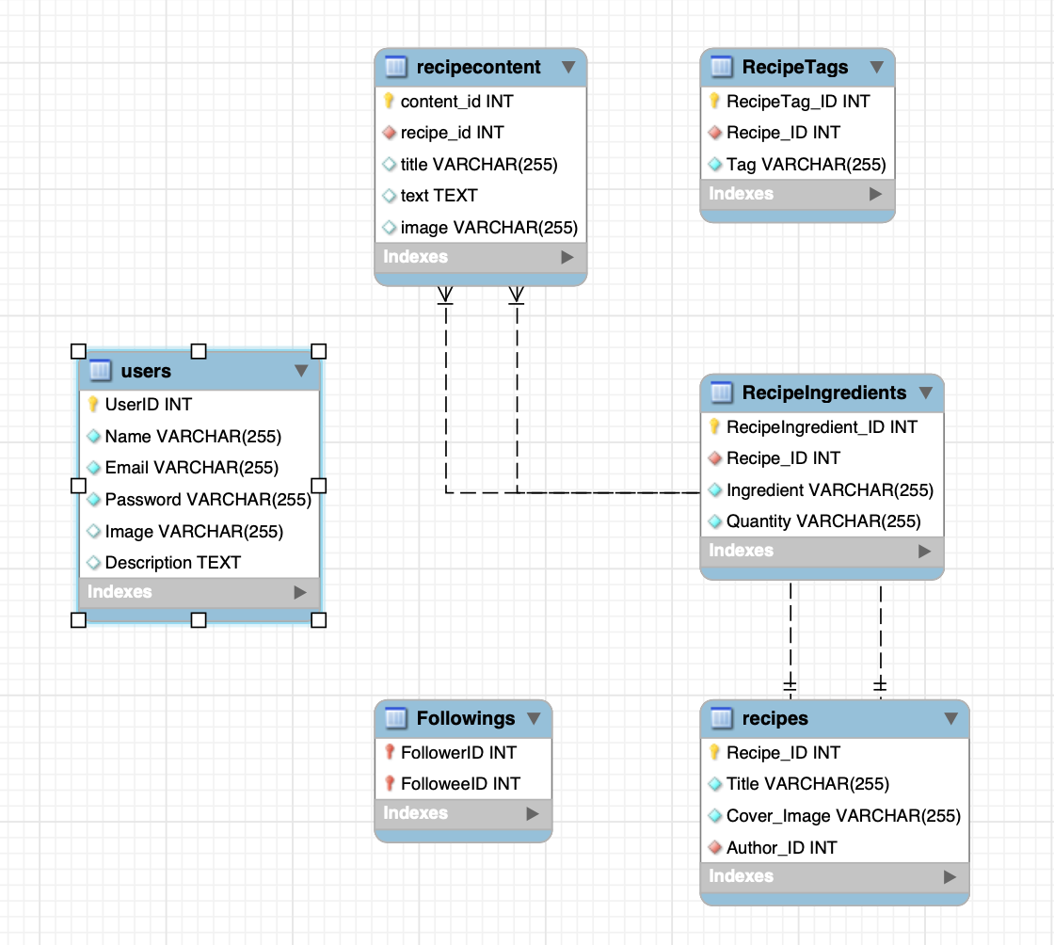
Normalization of Tables
Tables in 3NF

Slide 7
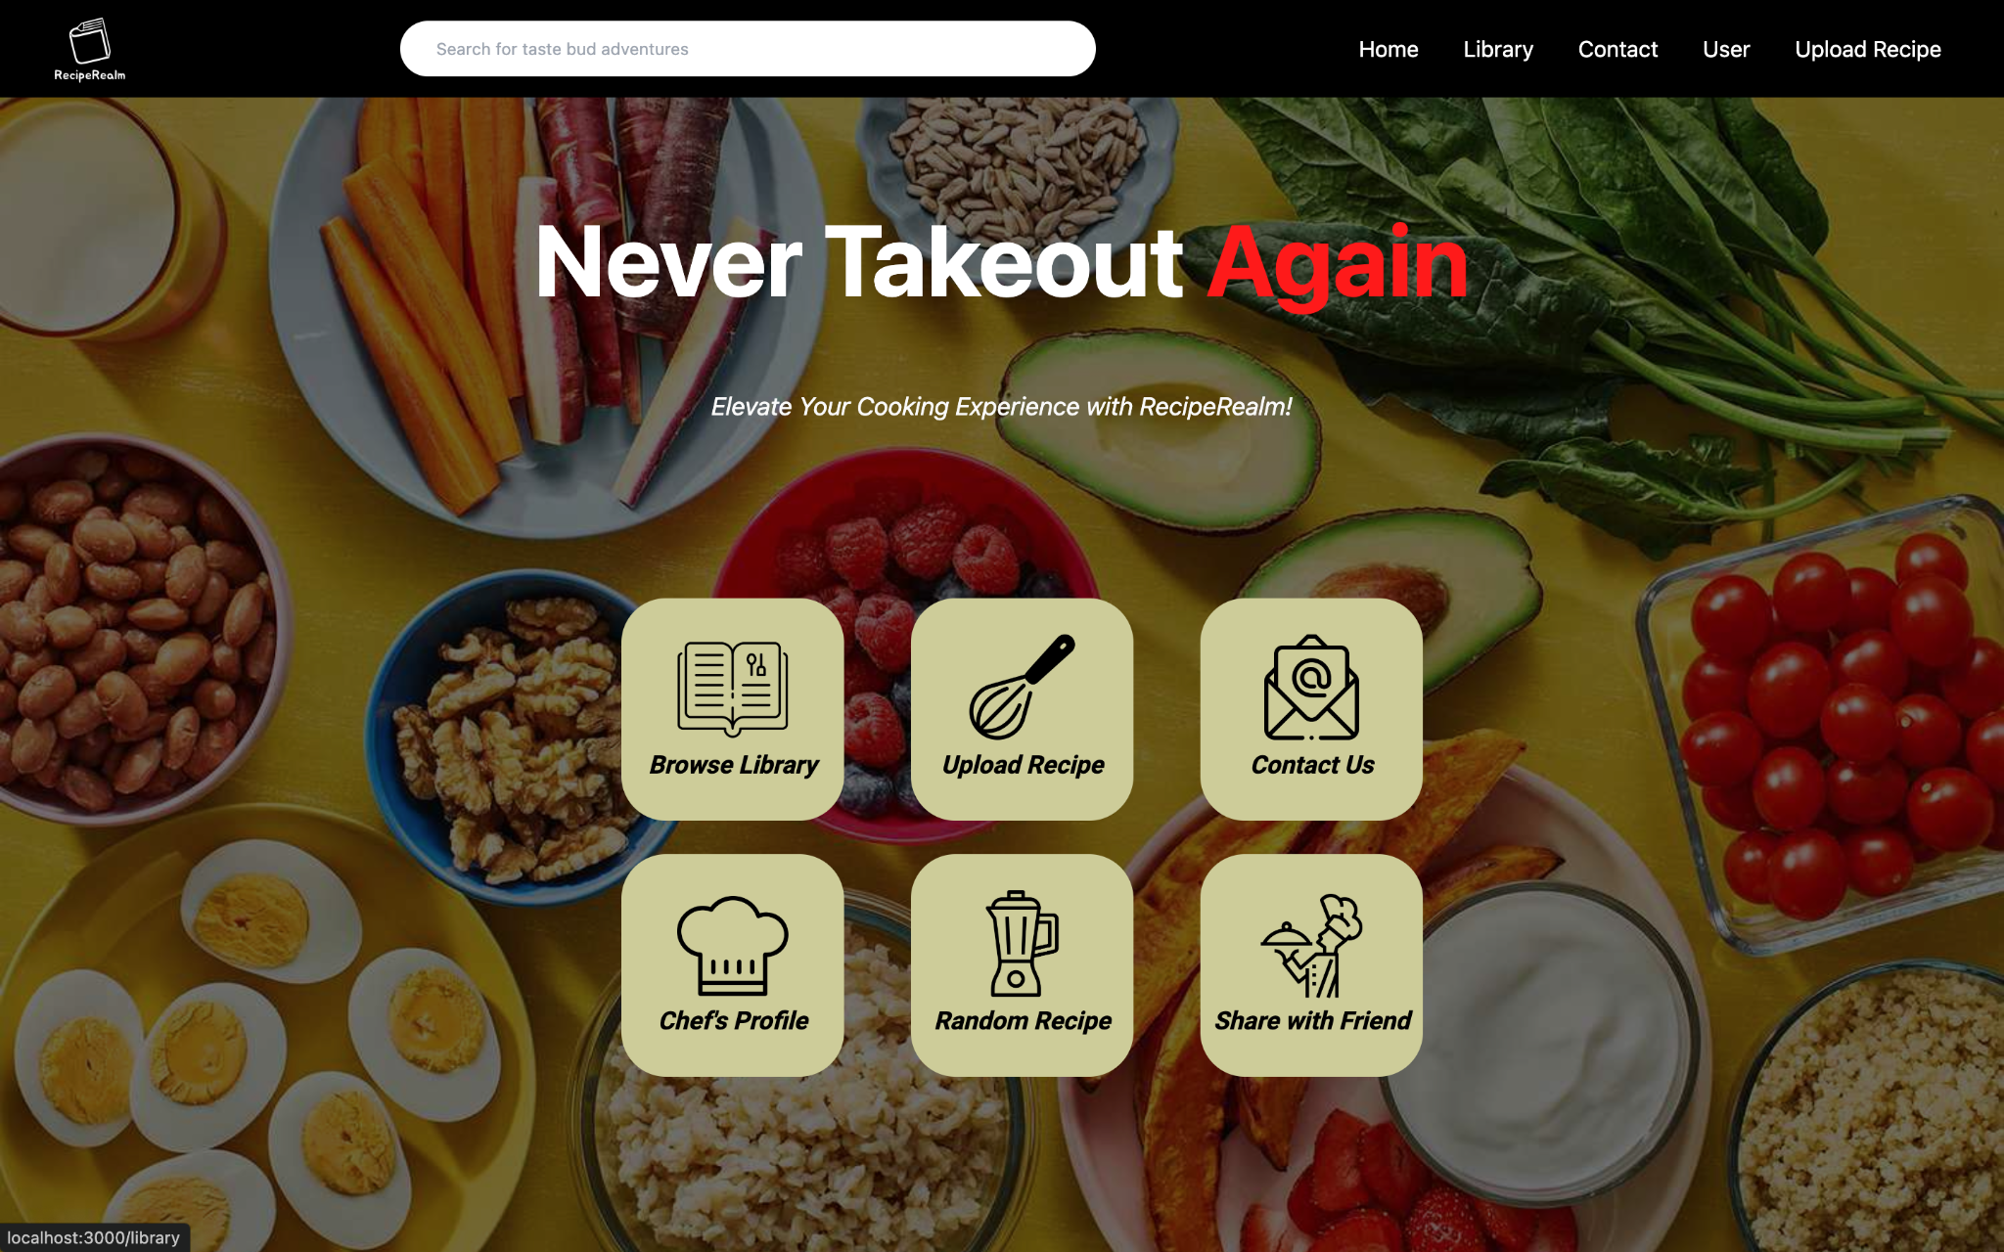
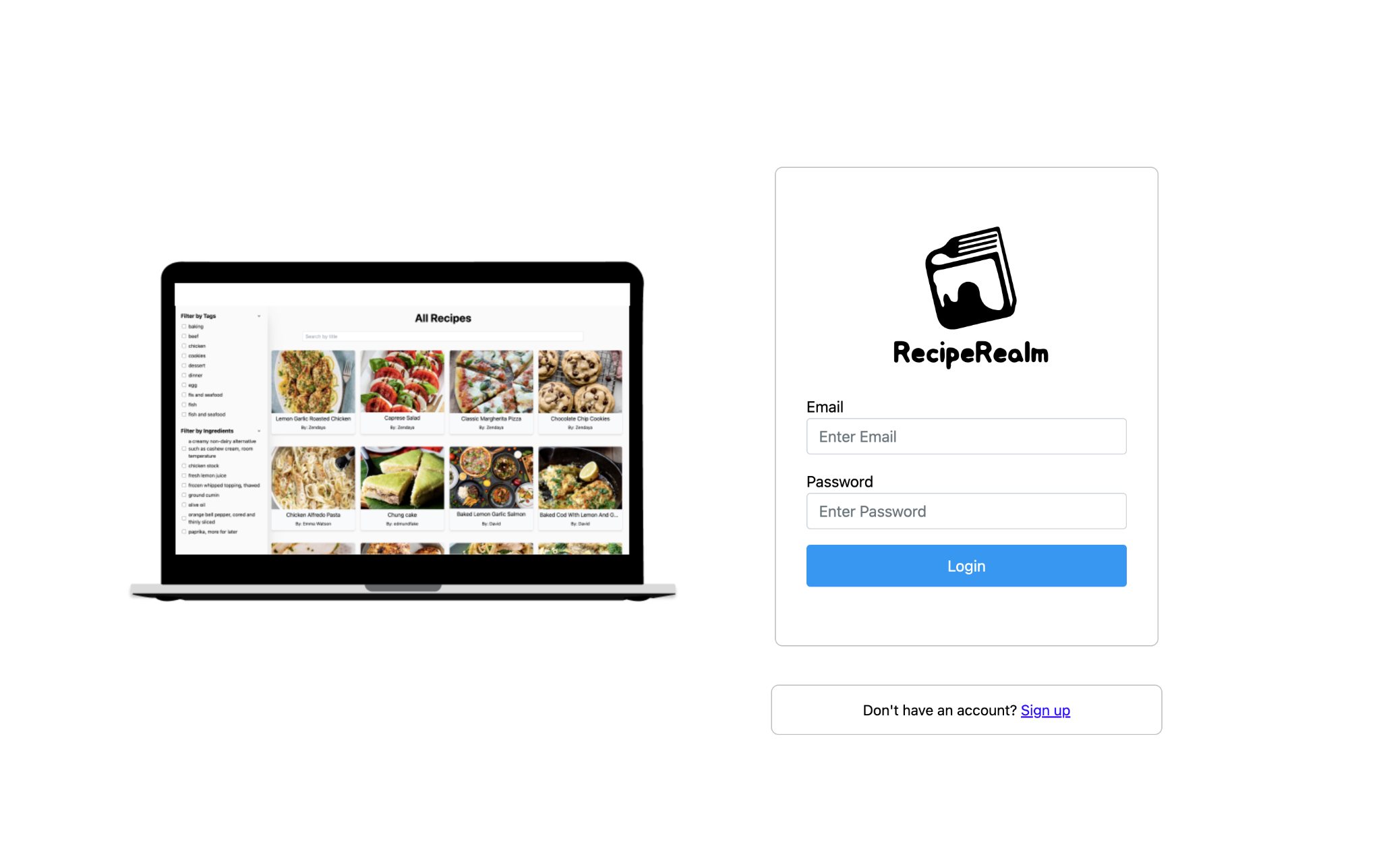
Results/Application Interface

Slide 8
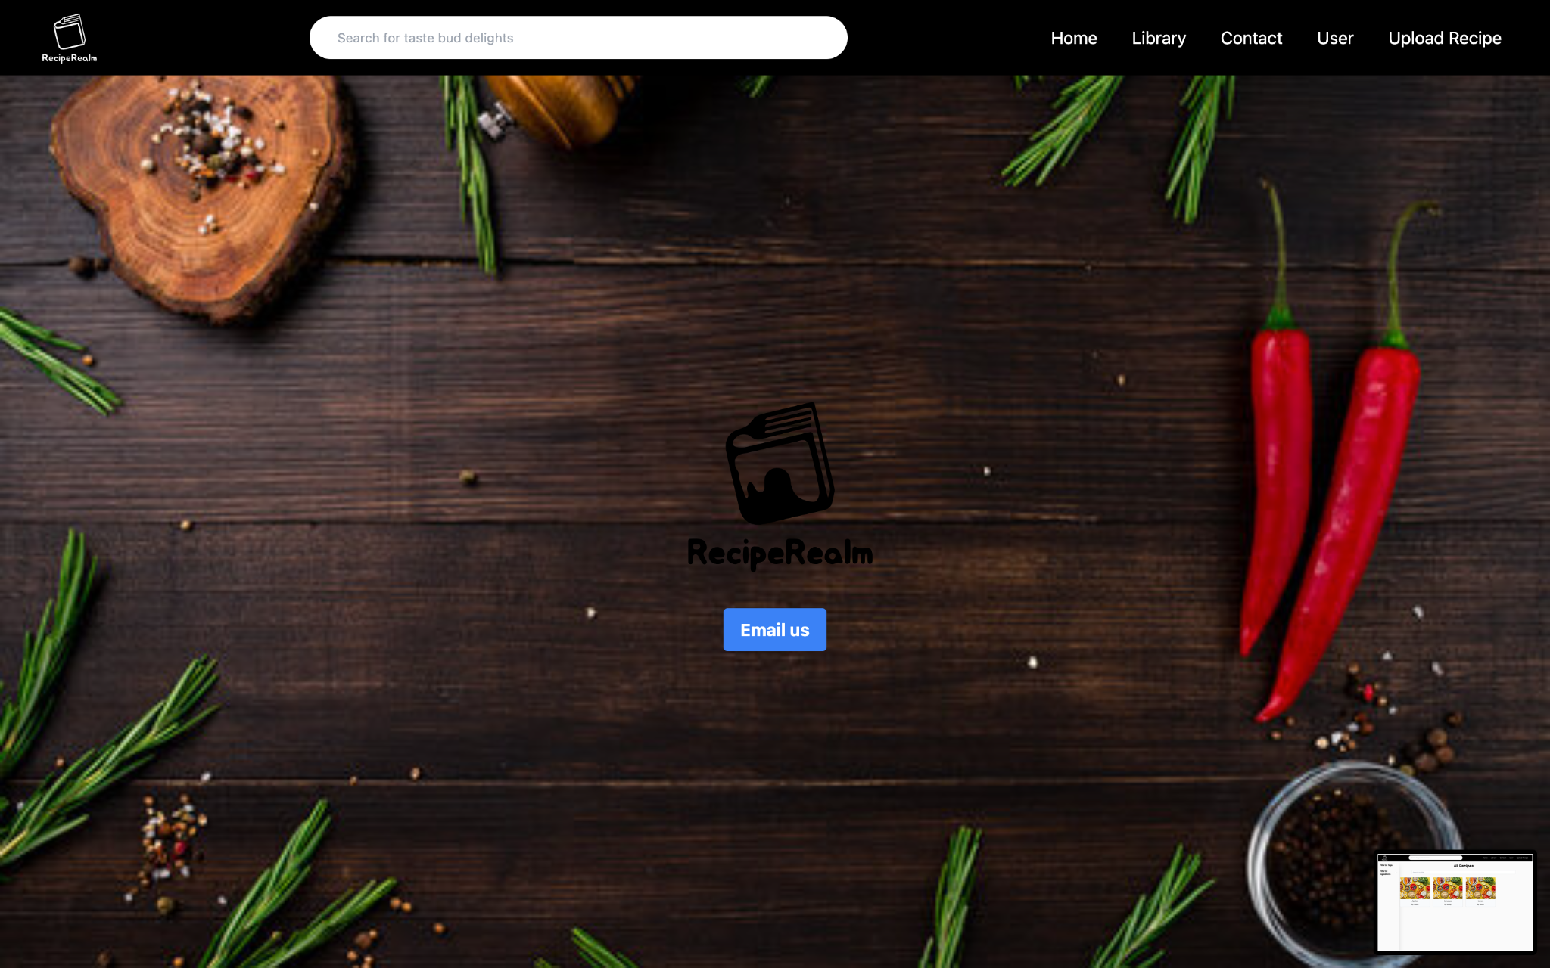
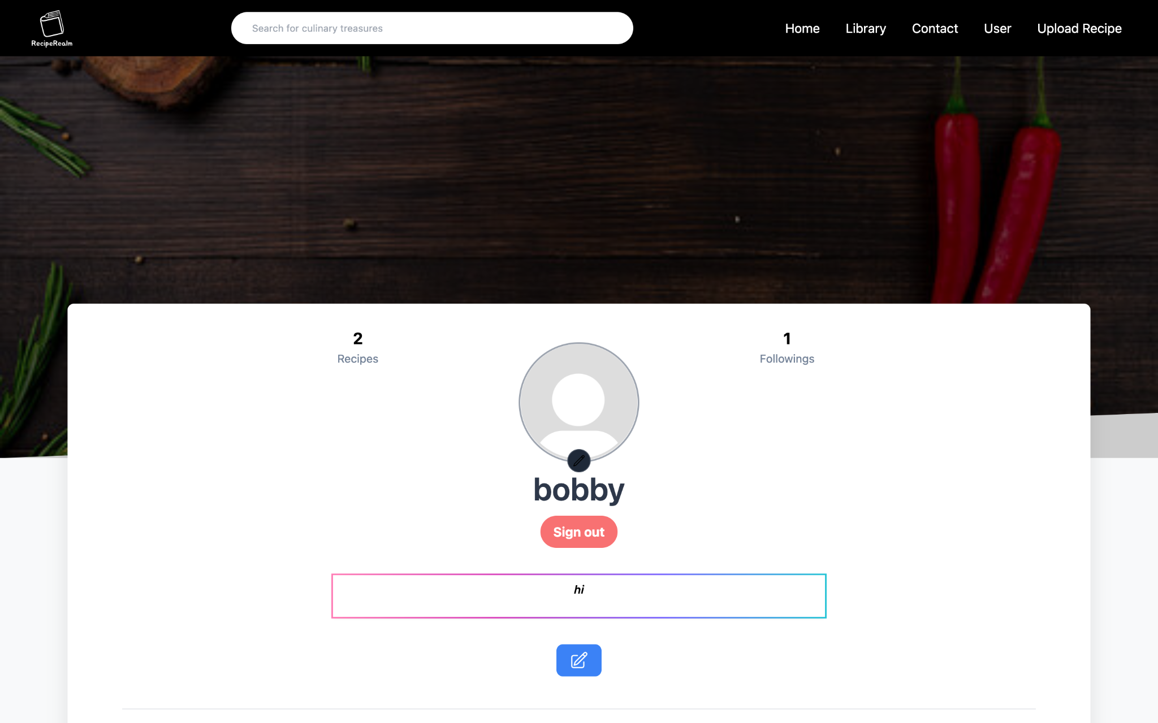
Results/Application Interface, cont.

Slide 9
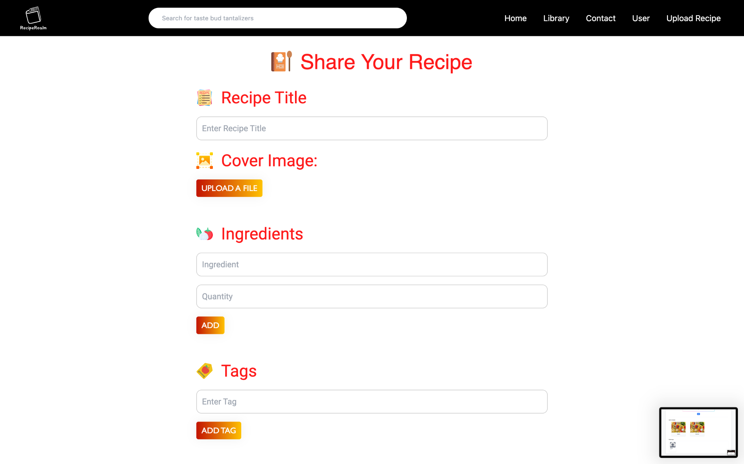
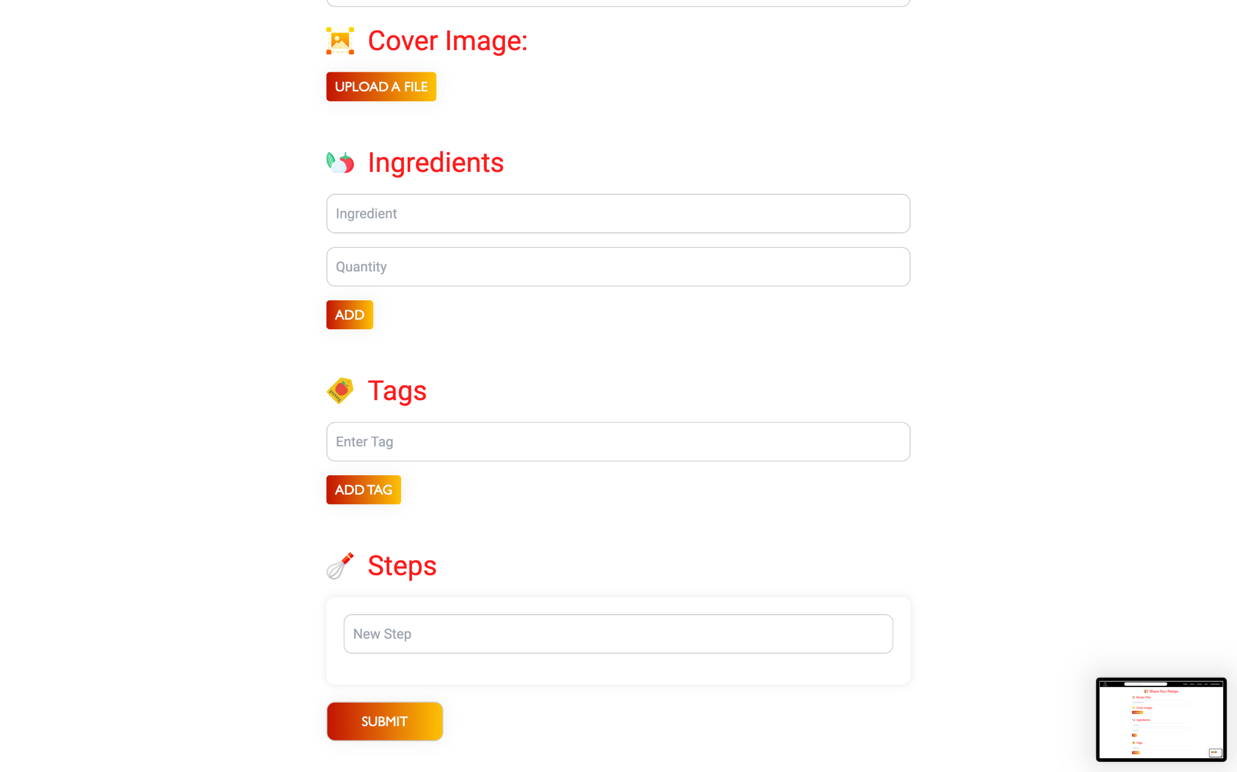
Results/Application Interface, cont.

Slide 10
Insights/Contributions
Rohan | Frederick | Ammar
Developed front-end components, developed back-end server-side logic, helped design and implement the database schema | High level design of entities/tables, ER diagram, report/documentation, helped with database design | Front end functionality, database schema construction, lead presenter, report/documentation with reference list formatting

Slide 11

DEMO

Slide 12

Questions For Us?

